Slide 1

BlueByte Hospitality Ltd: Setting the Standard in African Hospitality Excellence
A leading hospitality development and management company delivering world-class solutions across Nigeria and West Africa since 2009.

Slide 2
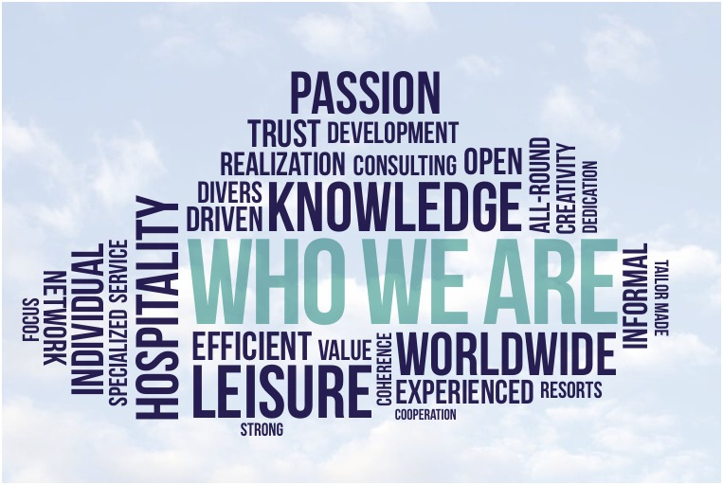



About Us
Our Foundation
Our Mission
Based in Lagos, Nigeria, we've redefined hospitality benchmarks since 2009.
Build exceptional hospitality assets that deliver sustained profitability and unforgettable experiences.
Our Partnership
Trusted partner to investors, developers, and hotel owners across Nigeria and West Africa.

Slide 3

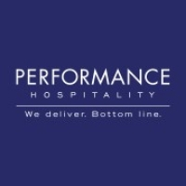

Core Found Pillars
Passion
Performance
Promise
We’re passionate about delivering unforgettable guest experience, driven by a love for hospitality and desire to exceed expectations.
We strive for operational excellence, leveraging our expertise to optimize efficiency, maximize revenue and elevate service standards.
We promise quality, integrity and attention to detail, ensuring every interaction is meaningful and every guest feels truly valued.

Slide 4
Our Services
Our services range from consultancy through construction, pre-opening and management development leading to complete turnarounds. We have extensive knowledge and expertise in the hospitality industry, which leads to a diverse set of competences we can offer. With these competencies we can provide you with several deliverables and disciplines with the hospitality industry while creating unique business ideas.
Pre-Opening & Business Development
Technical & Architectural Consultation
Hotel Pre-Opening Management
Feasibility & Market Analysis
Sales & Marketing Strategy
Staff Recruitment and Training
Asset Management
Design advisory & planning
Construction Coordination
Brand & Operator Selection
Operational Systems Integration
Food & Beverage Development
Training & Talent Development
Signature F & B Concepts
Cost Control & Menu Engineering
Events & Conferencing
International hospitality foundations
Guest Experience Management
Health & Safety Compliance

Slide 5
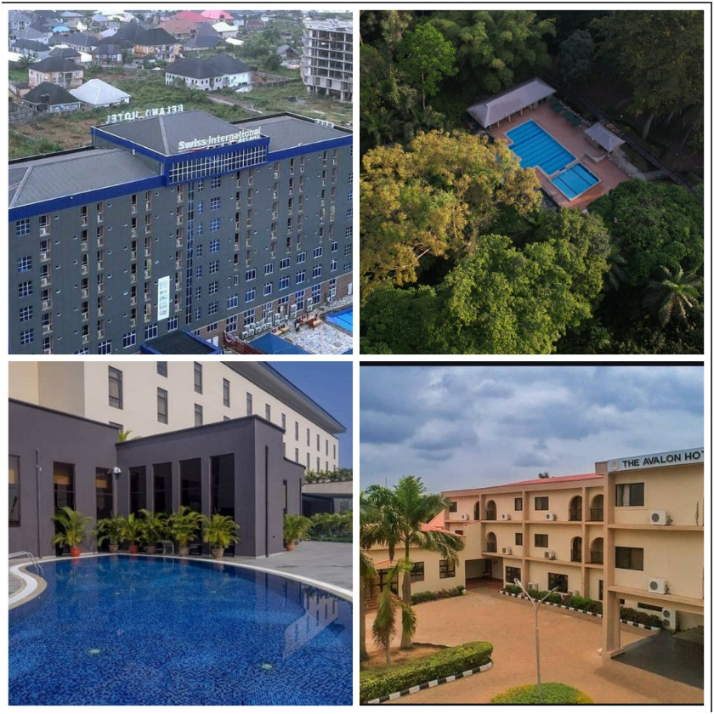
Our Projects & Clientele
1,500+
18+
Rooms Delivered
Hospitality Properties
Across Nigeria and West Africa
Project Completed. Successfully developed and managed.
8+
100%
Major Brands
Client Satisfaction
Including international and local partnerships
Including feedback for improvement

Slide 6






Why BlueByte Hospitality?
Excellence
Setting industry benchmarks
Partnership
Building lasting relationships
Performance
Delivering measurable results
With BlueByte Hospitality, you don't just open Hospitality projects —you establish a legacy through our authentic hospitality ethos centered on passion and precision.

Slide 7
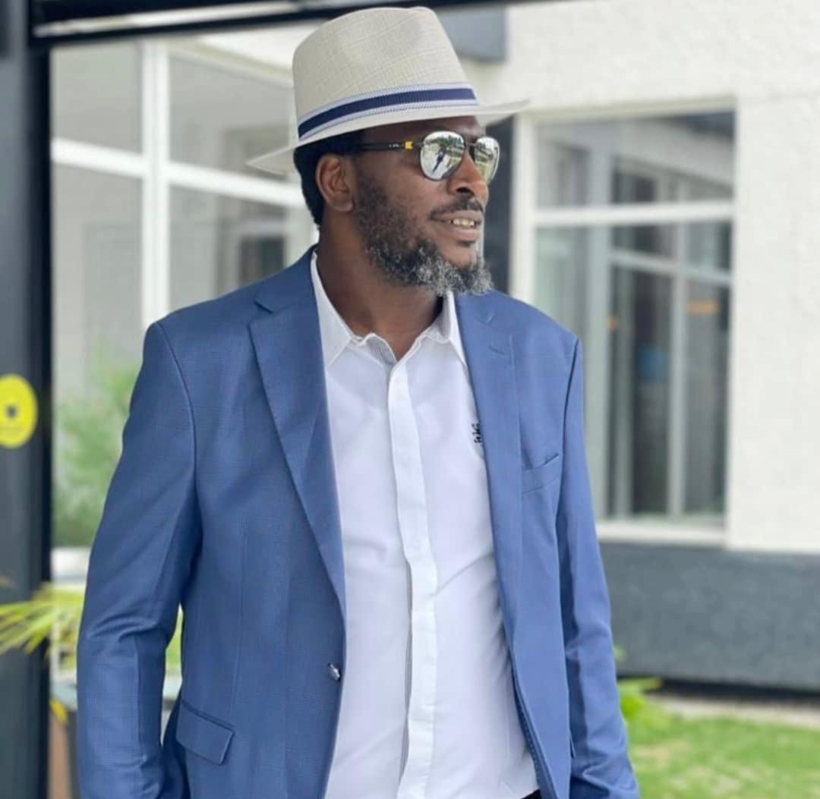




C.E.O’s Profile: Francis Chukwuka Ogosi FIH FTHC
Distinguished Leader
Over two decades of visionary expertise in Africa’s hospitality.
Professional Recognition
Fellow of the Institute of Hospitality (UK) and the Tourism and Hospitality Consultants (FTHC)
Achievements
Rehabilitated 1,500+ hotel rooms, shaped 18+ hospitality brands etc.
Current Role
Area Director, West Africa for Swiss International Hotels & Resorts and Hospitality Manager for Glocient Hospitality (Cavista Holdings)

Slide 8

C.E.O’s Profile: Francis Chukwuka Ogosi FIH FTHC
Core Strengths
Strategic thinking & Planning.
Operational expertise & management
Revenue growth and business development
Hospitality project development and management
Team leadership and development
Area of Specialization
Hospitality project & greenfield development
Hospitality market & financial feasibility studies
Hospitality architectural services & design review
Technical design services & concept development
Hospitality operator selector
Pre-opening, planning, complete installation & training

Slide 9

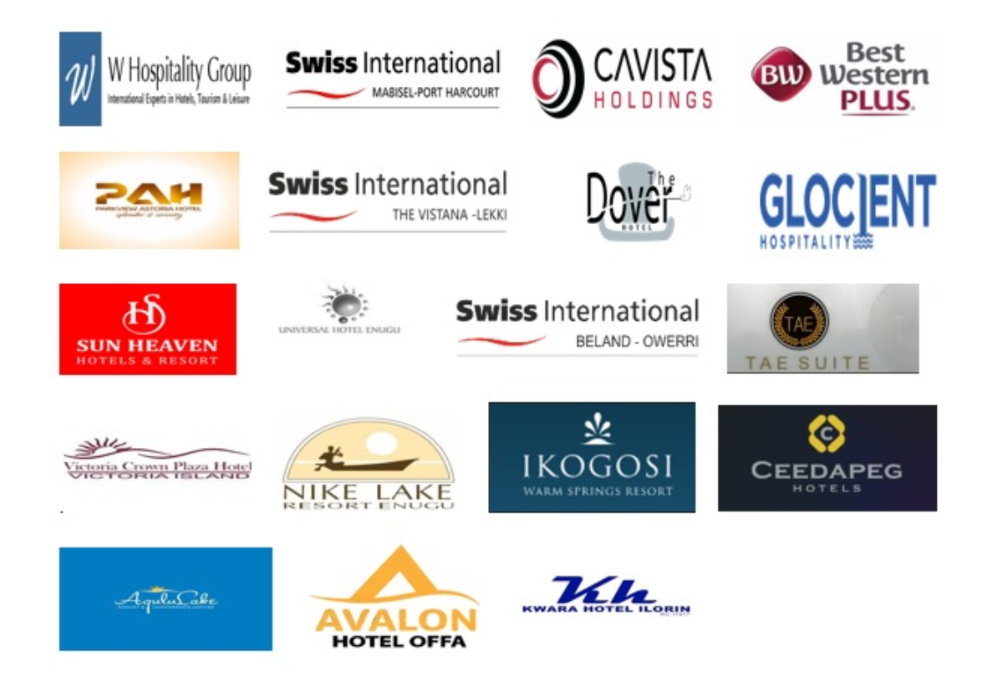
Contact Us
Address
Phone
Plot 15 block XV
Chief Abiodun Yesufu way,
Off Oniru market road, Lagos
+234 803 324 9250
Email
Website
francisogosi@bluebytehospitality.com
www.bluebytehospitality.com
info@bluebytehospitality.com

